Slide 1
Sports Activities
Submitted by : Abhayjeet singh
Anmolpreet Singh
Harjinder Singh

Slide 2
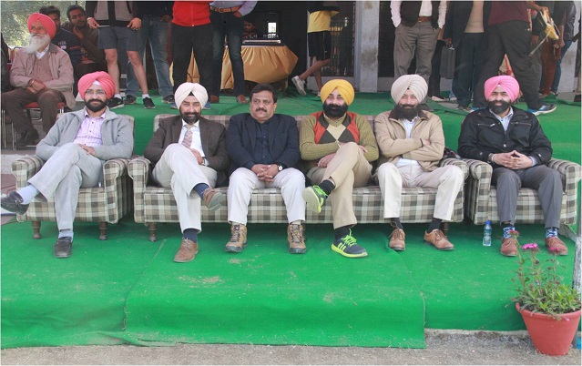
Dignities during the sports event

Slide 3
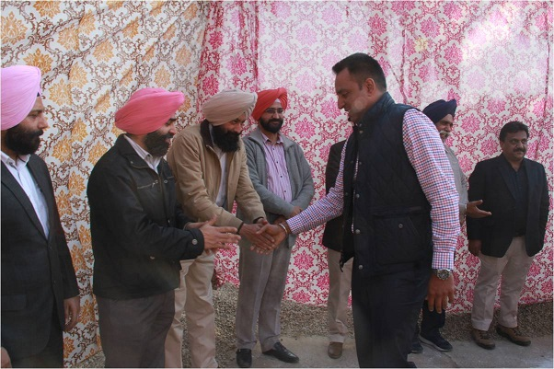
Welcoming the chief guest

Slide 4
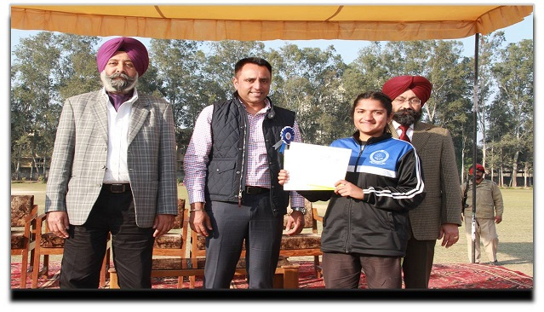
Kirti Malik (D4EE)
-Intercollege Lawn-tennis tournament(captain) – Gold
-Intercollege cross country tournament- Gold
-Intercollege handball tournament(captain)- Silver
-Intercollege athletic meet(captain)- Silver
-Javelin throw-Bronze
-4*400 relay- Gold

Slide 5
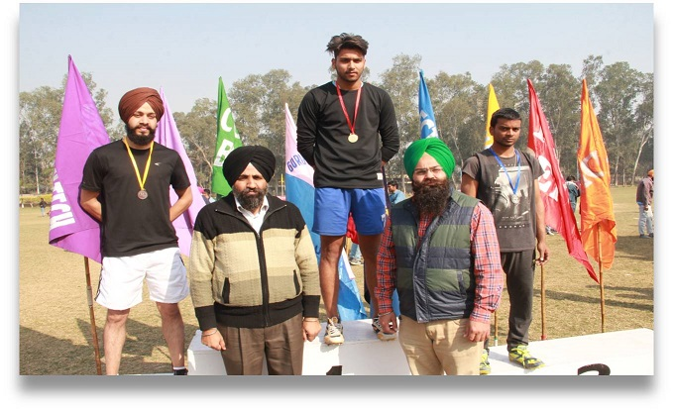
Gursimran Singh (D3EE)
-Sports meet - 100 m -Bronze
-Inter college basketball - Silver
-Inter year basketball - Gold
-Inter college athletics - 4×100 m Silver

Slide 6
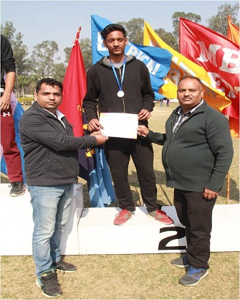
Balraj Sabharwal (D2EE)
Sports meet
- Long jump- Silver
- Inter college relay - Silver

Slide 7
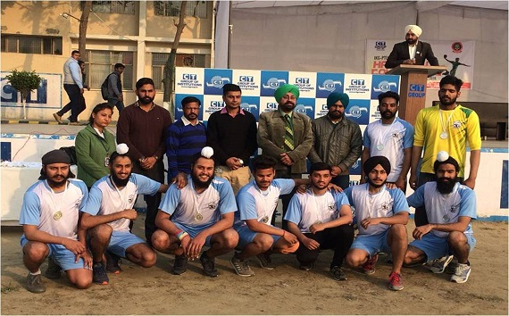
Tarun kumar Prince Malhi
D3 EE D3 EE
-Intercollege Handball - Silver

